Slide 1

Modern Query Processing Techniques for Graph Databases
Semih Salihoğlu

Slide 2
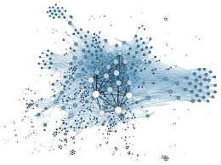
Challenge of Many-to-Many Joins
MATCH
WHERE a.age < d.age
RETURN a.ID, c.ID
a
b
c
d
Search-space grows exponentially by “average degree”
As a general rule: If the average degree is 1000:
1000³ many possible intermediate combinations to generate and search
Key takeaways of this part of the talk is modern theoretical work argue:
For some queries, cyclic ones, the search space can be decreased
For some queries, acyclic ones, the search space can be compressed

Slide 3
Outline
Worst-case Optimal Join Algorithms
Factorization: System Integration Example

Slide 4
Outline
Worst-case Optimal Join Algorithms
Factorization: System Integration Example

Slide 5
Worst-case Optimal Join Sizes
Given Q: R1 ⋈ R2 ⋈ … ⋈ Rn, what’s the max |OUT|?
Theorem 1 (AGM, FOCS 2008):
Assume |R_{i}| are equal. Let be a fractional edge cover:
Then: dddddddddd (IN is total input size)
1
1/2
𝞺* = 3/2
a
b
0
1/2
1/2
1
c
𝞺* : weight of minimum fractional edge cover

Slide 6
Traditionally: Binary Join (BJ) Plans
R1
R1
a | b
1 | 2
1 | 3
1 | 4
…
Table(s)/Q-Edge(s)-at-a-time Joins
a
b
R2
R3
c
INT₁
a | b | c
1 | 2 | 2
1 | 2 | 3
1 | 2 | 4
1 | 3 | 2
1 | 3 | 4
…
R2
a | c
1 | 2
1 | 3
1 | 4
…
Output
a | b | c
1 | 2 | 4
1 | 3 | 4
BJ Plans are provably suboptimal!
E.g: can generate m² intermediate tuples on a graph with m edges (AGM bound is m^{1.5})
R3
b | c
1 | 2
1 | 3
1 | 4
…

Slide 7
Generic Join: A WCO Algorithm (NPRR, 2013)
a | b
1 | 2
1 | 3
1 | 4
2 | 4
2 | 5
2 | 6
3 | 4
Column/Q-Vertex-at-a-time
Order q-vertices: say: a,b,c
a
b
c
∩
INT₁
a
a | c
1 | 2
1 | 3
1 | 4
2 | 4
2 | 5
2 | 6
3 | 4
b | c
1 | 2
1 | 3
1 | 4
2 | 4
2 | 5
2 | 6
3 | 4

Slide 8
Generic Join: A WCO Algorithm (NPRR, 2013)
a | b
1 | 2
1 | 3
1 | 4
2 | 4
2 | 5
2 | 6
3 | 4
Column/Q-Vertex-at-a-time
Order q-vertices: say: a,b,c
a
b
Q =
c
Int₁
a
1
2
3
INT₁
a
INT₂
a | b
a | c
1 | 2
1 | 3
1 | 4
2 | 4
2 | 5
2 | 6
3 | 4
b | c
1 | 2
1 | 3
1 | 4
2 | 4
2 | 5
2 | 6
3 | 4

Slide 9
Generic Join: A WCO Algorithm (NPRR, 2013)
a | b
1 | 2
1 | 3
1 | 4
2 | 4
2 | 5
2 | 6
3 | 4
Column/Q-Vertex-at-a-time
Order q-vertices: say: a,b,c
a
b
Q =
c
INT₁
a
1
2
3
INT₂
a | b
1 | 2
1 | 3
INT₂
a | b
a | c
1 | 2
1 | 3
1 | 4
2 | 4
2 | 5
2 | 6
3 | 4
∩
b | c
1 | 2
1 | 3
1 | 4
2 | 4
2 | 5
2 | 6
3 | 4

Slide 10
Generic Join: A WCO Algorithm (NPRR, 2013)
a | b
1 | 2
1 | 3
1 | 4
2 | 4
2 | 5
2 | 6
3 | 4
Column/Q-Vertex-at-a-time
Order q-vertices: say: a,b,c
a
b
Q =
c
INT₁
a
1
2
3
INT₂
a | b
1 | 2
1 | 3
2 | 4
2 | 5
2 | 6
3 | 4
Output
a | b | c
a | c
1 | 2
1 | 3
1 | 4
2 | 4
2 | 5
2 | 6
3 | 4
∩
b | c
1 | 2
1 | 3
1 | 4
2 | 4
2 | 5
2 | 6
3 | 4

Slide 11
Generic Join: A WCO Algorithm (NPRR, 2013)
a | b
1 | 2
1 | 3
1 | 4
2 | 4
2 | 5
2 | 6
3 | 4
Column/Q-Vertex-at-a-time
Order q-vertices: say: a,b,c
a
b
Q =
c
Output
a | b | c
1 | 2 | 4
1 | 3 | 4
INT₁
a
1
2
3
INT₂
a | b
1 | 2
1 | 3
2 | 4
2 | 5
2 | 6
3 | 4
Output
a | b | c
1 | 2 | 4
a | c
1 | 2
1 | 3
1 | 4
2 | 4
2 | 5
2 | 6
3 | 4
b | c
1 | 2
1 | 3
1 | 4
2 | 4
2 | 5
2 | 6
3 | 4
Theorem: GJ is WCO for any query (under any ordering)
E.g. will generate ≤ m^{1.5} intermediate tuples
11

Slide 12
Summary of Two Theorems
Theorem 1 (AGM Bound):
Assume |R_{i}| are equal. Let be min frac. edge cover:
Then: dddddddddd (IN is total input size)
Theorem 2 (GJ is WCO): Runtime of GJ ≤ AGM
(for any query & any q-vertex ordering (QVO))
Message: To be WCO:
do q-vertex-at-a-time matching w/ multiway intersections.

Slide 13
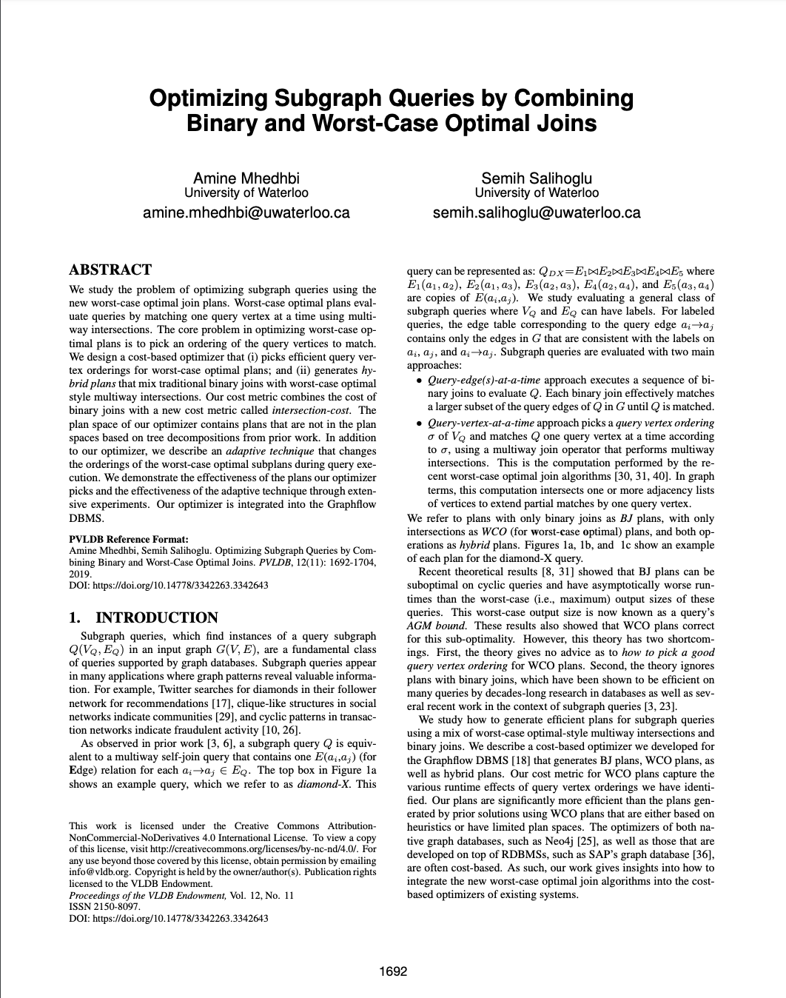
Research Questions
How should the query vertex orderings be picked?
For which queries are WCO, BJ or Hybrid plans good?
How to mix multiway intersections w/ BJs?
c
c
c
c
c
c
c
c
c
b
b
b
b
b
b
b
b
b
d
d
d
d
d
d
d
d
d
a
a
a
a
a
a
a
a
a
h
h
h
h
h
h
h
h
h
e
e
e
e
e
e
e
e
e
g
g
g
g
g
g
g
g
g
f
f
f
f
f
f
f
f
f
Finds all paths of length 6!!
Maybe WCO but clearly impractical.
VLDB 2019
Notes:
We wrote one of the first papers on integrating these new multiway intersection-based join algorithms into a database management system studying several questions, such as X, Y, Z. We introduce new cost model and dynamic programming-based optimizer that seamlessly mix wco-style intersection-based joins with binary joins.

Slide 14
Graphflow Logical and Physical Plans for SQs
Storage: 2 adjacency lists per vertex (fw & bw) stored in memory
Logical Plan
(Hybrid) Logical Plan
Physical Plan
(WCO) Logical Plan
QVO: c,d,b,a
b
HashJoin (b,c)
b
a
d
a
d
c
c
b
b
Ext/Int (b)
a→ ∩ c←
Ext/Int (b)
c← ∩ d→
b
a
d
d
c
c
c
a
d
ScanE
a→c
ScanE
c→d
d
c
c
c

Slide 15
Q1: Ordering QVOs: Good Orders
Two main effects of QVOs:
First Effect: # intermediate partial matches.
P1: QVO: c,d,b,a
P2: QVO: c,d,a,b
b
b
a
d
a
d
c
c
 | P1 | P2
Intermediate Matches | 3.5M | 40M
Run time | 9s | 16s
b
a
d
d
c
c
Soc-Epinions
d
d
c
c

Slide 16
Q1: Ordering QVOs: Good Orders
2nd Effect: Directions of adjacency lists intersected.
P1:QVO: a,b,c
P2: QVO: a,c,b
P3: QVO: b,c,a
b
b
b
a
a
a
c
c
c
 | P1 | P2 | P3
Run time | 3s | 15s | 31s
b
b
a
Web-BerkStan
a
c
c
src→ ∩ dst→
src→ ∩ dst←
src← ∩ dst←
Graphflow Optimizer: Minimize estimated intersection cost (i-cost)
I-cost: ∑ (size-of-adj-lists-intersected-throughout-execution)
(Requires estimating the # partial matches & average adj-list sizes)

Slide 17
Q2: How to mix BJs with Intersections?
Cost-based DP optimization algorithm.
b
a
d
c
Optimum Plans for all connected sub-queries with 2 q-vertices:
a
b
a
c
b
c
c
d
d
b
Optimum Plans for all connected sub-queries with 3 q-vertices:
b
b
b
a
d
a
d
a
d
c
c
c
Optimum Plans for all connected sub-queries with 4 q-vertices:
b
a
d
c
Each step: consider plans with both hash joins & intersections.

Slide 18
Graphflow vs Empty-Headed Hybrid Plans
f
f
 | Amzn | Web
GF | 24.7s | 6.5m
EH | 0.5hrs | >5 hrs
EH in GF | 5.8m | 42m
b
e
b
e
c
c
a
d
a
d
b
e
f
f
c
b
e
a
d
c
c
a
d
b
e
b
e
c
c
c
c
a
d
a
d
c
c
c
c
a
d
a
d
Graphflow
EmptyHeaded

Slide 19
Q3: For Which Queries are WCO, BJ, Hybrid Plans Good?
Size and cyclicity
b
b
a
b
c
a
d
a
d
c
c
f
e
d
Soc-Epinions
Soc-Epinions
Amazon

Slide 20
Outline
Worst-case Optimal Join Algorithms
Factorization: System Integration Example

Slide 21
Processing In Traditional Processors
Columnar RDBMSs, e.g., Vectorwise, MonetDB, Vertica, DuckDB
Optimized for OLAP workloads (online analytical processing)
Read-heavy but joins are not m-n, and aggregation-heavy
Operators process a block of flat tuples at-a-time in for loops.
SELECT dep, avg(age)
FROM Employee E
WHERE age > 30
GROUP BY dep
Scan Employees: age > 30, dep
GroupBy & Aggregate
key: dep, aggr: avg(age)
dep | age | fmask
IT | 25
Sales | 29
HR | 34
HR | 35
Sales | 46
dep | age | fmask
IT | 25 | 0
Sales | 29
HR | 34
HR | 35
Sales | 46
dep | age | fmask
IT | 25 | 0
Sales | 29 | 0
HR | 34
HR | 35
Sales | 46
dep | age | fmask
IT | 25 | 0
Sales | 29 | 0
HR | 34 | 1
HR | 35
Sales | 46
dep | age | fmask
IT | 25 | 0
Sales | 29 | 0
HR | 34 | 1
HR | 35 | 1
Sales | 46
dep | age | fmask
IT | 25 | 0
Sales | 29 | 0
HR | 34 | 1
HR | 35 | 1
Sales | 46 | 1
Employee
eID | age | dep
3121 | 25 | IT
2431 | 29 | Sales
1113 | 34 | HR
5110 | 35 | HR
9926 | 46 | Sales
dep | age
IT | 25
Sales | 29
HR | 34
HR | 35
Sales | 46
Block-based: Good CPU utilization
Flat Tuples: Not optimized for m-n joins

Slide 22
Repetitions in Traditional Processors
MATCH
WHERE b.name=‘Liz’ AND
RETURN a.ID, c.ID
a
b
c
U₁
C₁
…
…
L₁
…
…
U₁₀₀
C₁₀₀
…
…
L₂
…
…
Scan (b)
name=Liz
Extend (a)
Extend (c)
U₁₉₉
C₁₉₉
b | name | fmask
L₁ | Liz | 1
L₂ | Liz | 1
U₁ | Ken | 0
… | … | …
U₁₉₉ | Bob | 0
b | name | a | c
L₁ | Liz | U₁ | C₁
L₁ | Liz | U₁ | C₂
 | … | … | …
L₁ | Liz | U₁ | C₁₀₀
L₁ | Liz | U₂ | C₁
L₁ | Liz | U₂ | C₂
… | … | … | …
L₁ | Liz | U₂ | C₁₀₀
Repetition happens b/c 1 group of vectors represent a block of flat tuples

Slide 23
Factorized Relation Representations (F-Reps)
Flat Representation
F-Representation
b | name | a | c
L₁ | Liz | U₁ | C₁
 | … | … | …
L₁ | Liz | U₁ | C₁₀₀
L₂ | Liz | U₁₀₀ | C₁₀₀
… | … | … | …
L₂ | Liz | U₁₉₉ | C₁₀₀
b, name |  | a |  | c
{L₁, Liz} | X | {U_{1,}…, U₁₀₀} | X | {C₁, …, C₁₀₀}
U
{L₂, Liz} | X | {U_{100,}…, U₁₉₉} | X | {C₁₀₀, …, C₁₉₉}
2x(100+100) tuples
2x(100x100) tuples
Outputs of a query Q can be factorized by analyzing the conditional independence of the variables in Q
E.g. in : once b is fixed, a and c are independent
a
b
c
Factorized Vectors: Represent intermediate tuples in *multiple vector groups*
Olteanu et. al. Factorized Databases, SIGMOD Record, 2016

Slide 24
F-Representation-based Processing
MATCH
WHERE b.name=‘Liz’
RETURN a.ID AND c.ID
U₁
C₁
a
b
c
…
…
L₁
…
…
U₁₀₀
C₁₀₀
…
…
L₂
…
…
U₁₉₉
C₁₉₉
Scan (b)
name=Liz
Extend (a)
Extend (c)
Fact. Vec. 1
Fac. Vec. 2
Fac. Vec. 3
b | name | fmask
L₁ | Liz | 1
L₂ | Liz | 1
U₁ | Ken | 0
… | … | …
U₁₉₉ | Bob | 0
a
U₁
U₂
…
U₁₀₀
c
C₁
C₂
…
C₁₀₀
a
U₁₀₀
U₁₀₁
…
U₁₉₉
c
C₁₀₀
C₁₀₁
…
C₁₉₉
c
curIdx = -1
curIdx = -1
curIdx = 1
curIdx = 2
curIdx = -1

Slide 25
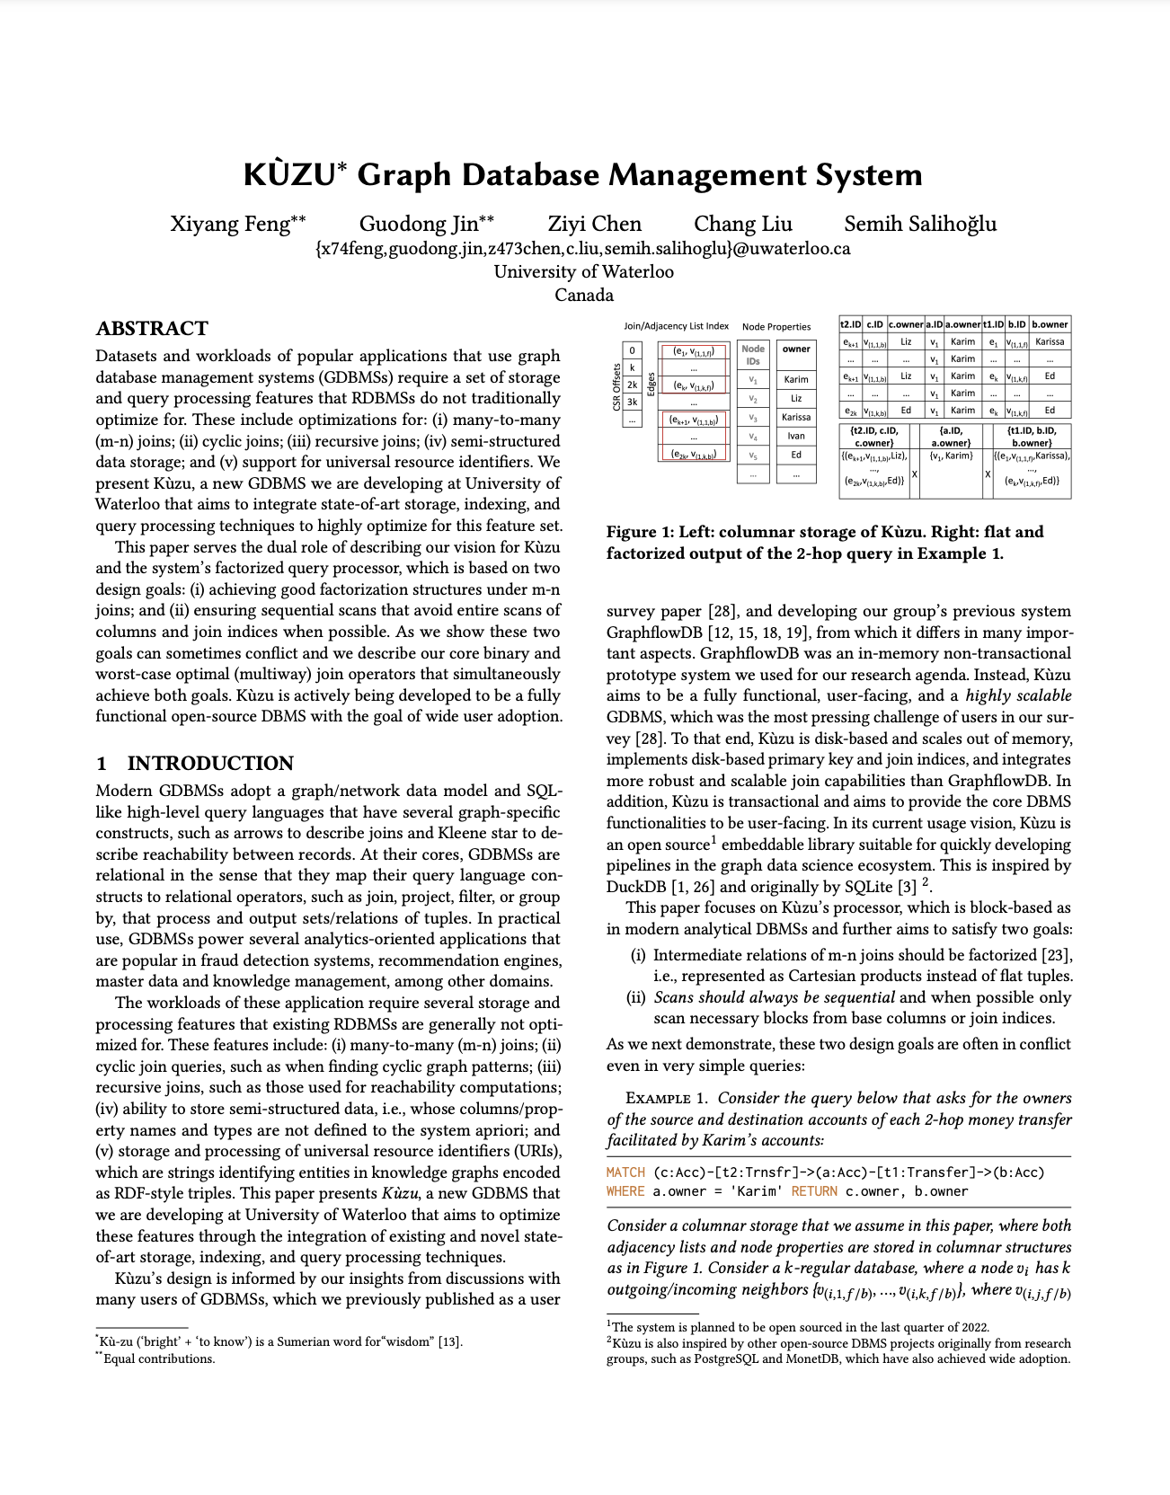
F-Representation-based Processing in Kùzu
Kùzu query processors adopts factorized vectors
But does not use “Extend”-like operators
Instead they use hash-join based operators (for very good reasons)
CIDR ‘23
Feng et. al., Kùzu Graph Database Management System CIDR 2023

Slide 26
Design Goals for Fast Joins in Kùzu
Factorize/compress intermediate results under m-n joins
Always perform sequential scans of nodes, edges & properties
Behave similar to Hash Joins that are common in RDBMS
Avoid full scans of properties when possible
Notes:
When designing Kuzu’s query processor and join operators we had the following 3 design goals. First, we wanted to optimize the system for m-n joins, which by their nature generate growing intermediate results. Our first design goals was to compress these results using a specific technique called factorization. Second, we wanted the scans from disk to be only sequential, and this might surprise some but this is actually not the common wisdom in many GDBMSs, which do INLJ-type joins, which may lead to non-sequential scans. Instead we wanted to adopt Hash Joins, which is the common wisdom in RDBMSs. However, we also wanted to avoid full scans of disk files, when e.g., scanning only the neighbors of a small number of nodes.

Slide 27
2. & 3. Sequential Scans But Avoid Full Scans
Common Join/Scan Practice in GDBMSs:
MATCH (a:P)-[e:Knows]->(b:P) WHERE a.name = “Liz” RETURN b.name
Scan Node
a.name = “Liz”
Extend
(a)-[e:Knows]->(b)
Scan
b.name
Typical index nested-loop joins
Another index nested-loop join
0
…
7
…
… | …
b.name
…
Alice
…
Ken
…
Noura
…
Index Nested Loop Joins:
non-sequential/random reads b/c neighbors have no locality
but avoid full table scans
…
107 | 5 | 15
X
107
✓
…
7
5
15
disk column

Slide 28
2. & 3. Sequential Scans But Avoid Full Scans
Common Join/Scan Practice in RDBMSs:
SELECT b.name
FROM Person a, Knows e, Person b
WHERE a.name=“Liz” AND e.src=a.ID AND e.dst=b.ID
…
Hash Joins & Full Table Scans
Scan “build side” & create ht
Scan “probe side” & probe into ht
sequential
but always full table scans
srcID | dstID | a.name
7 | 107 | Liz
7 | 15 | Liz
Hash Table
key | values
7 | Liz
19 | Liz
Hash Join
e.srcID = a.ID
…
✓
srcID | dstID
7 | 107
8 | 66
7 | 15
X
a.ID | name
7 | Liz
19 | Liz
Scan Knows (e)
Scan Person (a)
a.name = Liz

Slide 29
Back to Our Design Goals
Factorize intermediate results
Always perform sequential scans of node/edge properties
Avoid full scans of properties when possible
Factorized Vectors
INLJ (e.g., Extend)
Hash Joins
Kùzu Core Join Operators:
Process Factorized Vectors
Hash Joins w/ sideways information passing to avoid full scans
2 operators: SJoin and ASPJoin

Slide 30
…
SJoin Example
Pass IDs of “joining” nodes/edges sideways from build side of HJs to the probe sides to avoid full table scans
MATCH (a:Person)-[:Knows]->(b:Person)
WHERE a.name=‘Liz’ RETURN count(*)
(a.ID, a.name) |  | b.IDs
(7, Liz) | X | {107, 5, 15}
0
…
7
…
… | …
…
semijoin mask on ID
p₁ | … | p₇ | … | p_{1M}
0 | .. | 1 | … | 0
SJoin
Hash Table
key | values
7 | Liz
107 | 5 | 15
…
ID | name
7 | Liz
Scan + Semijoin
(a)->(b) Knows
Scan
Person a
name=Liz
From |  | To
7 | X | {107, 5, 15}

Slide 31
Example: Back to 2-hop query
MATCH
WHERE b.name=‘Liz’
RETURN a.name, b.ID, c.name
U₁
C₁
a
b
c
…
…
…
…
L₁
U₁₀₀
C₁₀₀
…
…
L₂
…
…
U₁₉₉
C₁₉₉
Desired factorization : {(a₁, a₁.name), …, (a_{k1}, a_{k1}.name)} X b_{i} X {c₁.name, …, (c_{k2}, c_{k2}.name)}.
unflat: set of
(a, a.name) values
flat: single
b.ID value
unflat: set of
(c, c.name) values
Problem: If we want to join a.name and c.name values with hash joins, we often need to “flatten” them when performing hash joins.

Slide 32
Example: Back to 2-hop query
MATCH
WHERE b.name=‘Liz’
RETURN a.name, b.ID, c.name
a
b
c
This SJoin needs to flatten c.ID to join c.name.
=> can’t obtain our desired factorization structure
c.name
…
Alice
…
Ken
…
Noura
…
…
0
…
7
…
… | …
…
SJoin
107 | 5 | 15
b.ID |  | c.IDs
7 | X | {107, 5, 15}
Scan + Semijoin
Person c.name
SJoin
Scan + Semijoin
(b)->(c) Knows
Scan
Person b
name = Liz

Slide 33
ASPJoin Example
…
b.ID |  | {c.IDs, c.names}
7 | X | {(107, Noura), (5 Alice), (15, Ken)}
Hash Table
key/c.ID | value/name
5 | Alice
15 | Ken
107 | Noura
ASPJoin
3. Probe
2. Build
1 .Accumulate
Scan Factorized Table
Accumulate
Factorized Table
semijoin mask on ID | semijoin mask on ID
… | p₅ | … | p₁₅ | … | p₁₀₇ | …
… | 1 | ... | 1 | … | 1 | …
b.ID |  | c.IDs
7 | X | {107, 5, 15}
b.ID |  | c.IDs
7 | X | {107, 5, 15}
Scan + Semijoin
Person c.name
SJoin
Factorize intermediate results
Sequential property scans
Avoid full scans
✓
✓
Scan
Person b
name = Liz
Scan + Semijoin
(b)->(c) Knows
…
✓

Slide 34
Example Microbenchmark Experiment
MATCH (a:Comment)<-[:Likes]-(b:Person)-[:Likes]->(c:Comment)
WHERE b.ID < X
RETURN min(a.ID), min(b.ID), min(c.ID)
LDBC 100: 220M Comments & 0.5M Person nodes, 242M Likes edges
8 threads, 64GB RAM
Selectivity | Kùzu | Kùzu-INLJ | Umbra
0.01% | 0.33s | 0.01s | 1.90s
0.1% | 0.41s | 0.11s | 4.05s
1% | 0.96s | 1.04s | 12.30s
10% | 3.89s | 10.39s | 230.35s
100% | 31.98s | 92.35 | TO
CIDR ‘23
Further advanced join techniques for “cyclic” patterns in the paper…

Slide 35
Limitations
When adjacency lists are small, factorized vectors degenerate to Volcano-style tuple-at-a-time processing.
Can only do “1-depth” factorization structures. Cannot generate a nested factorization structure:
a
MATCH
b
c
d
e
f
g
Need general tries but unclear how to do query processing on tries.

Slide 36
Example Microbenchmark Experiment
MATCH (a:Comment)<-[:Likes]-(b:Person)-[:Likes]->(c:Comment)
WHERE b.ID < X
RETURN min(a.ID), min(b.ID), min(c.ID)
LDBC 100: 220M Comments & 0.5M Person nodes, 242M Likes edges
8 threads, 64GB RAM
Selectivity | Kùzu | Umbra
0.01% | 0.33s | 1.90s
0.1% | 0.41s | 4.05s
1% | 0.96s | 12.30s
10% | 3.89s | 230.35s
100% | 31.98s | TO
CIDR ‘23
Further advanced join techniques for “cyclic” patterns in the paper…

Slide 37
Further Value Repetitions
MATCH
WHERE a.cntr=‘US’ & e.cntr=‘CAN’
D₁
a
b
c
d
C₁
B₁
D₂
A₁
C₂
B₂
D₃
Most compact output: relevant subgraph
C₃
A₂
B₃
D₄
Scan (a)
cntr=`US’
Extend (b)
Extend (c)
Extend (d)
C₄
D₅
LG1
LG2
LG3
LG4
a |  | b |  | c |  | d
…
{A₁} | X | {B₁} | X | {C₂} | X | {D₂, D₃}
{A₁} | X | {B₂} | X | {C₂} | X | {D₂, D₃}
{A₁} | X | {B₂} | X | {C₃} | X | {D₃, D₄}
{A₂} | X | {B₂} | X | {C₂} | X | {D₃, D₄}
{A₂} | X | {B₂} | X | {C₃} | X | {D₃, D₄}
…
F-Representation

Slide 38
Further Value Repetitions
MATCH
WHERE a.cntr=‘US’ & e.cntr=‘CAD’
D₁
a
b
c
d
C₁
B₁
D₂
A₁
C₂
B₂
D₃
Most compact output: relevant subgraph
C₃
A₂
B₃
D₄
Scan (a)
cntr=`US’
Extend (b)
Extend (c)
Extend (d)
C₄
D₅
LG1
LG2
LG3
LG4
a |  | b |  | c |  | d
…
{A₁} | X | {B₁} | X | {C₂} | X | {D₂, D₃}
{A₁} | X | {B₂} | X | {C₂} | X | {D₂, D₃}
{A₁} | X | {B₂} | X | {C₃} | X | {D₃, D₄}
{A₂} | X | {B₂} | X | {C₂} | X | {D₃, D₄}
{A₂} | X | {B₂} | X | {C₃} | X | {D₃, D₄}
…
F-Representation

Slide 39
Further Value Repetitions
MATCH
WHERE a.cntr=‘US’ & e.cntr=‘CAD’
D₁
a
b
c
d
C₁
B₁
D₂
A₁
C₂
B₂
D₃
Most compact output: relevant subgraph
C₃
A₂
B₃
D₄
Scan (a)
cntr=`US’
Extend (b)
Extend (c)
Extend (d)
C₄
D₅
LG1
LG2
LG3
LG4
a |  | b |  | c |  | d
…
{A₁} | X | {B₁} | X | {C₂} | X | {D₂, D₃}
{A₁} | X | {B₂} | X | {C₂} | X | {D₂, D₃}
{A₁} | X | {B₂} | X | {C₃} | X | {D₃, D₄}
{A₂} | X | {B₂} | X | {C₂} | X | {D₃, D₄}
{A₂} | X | {B₂} | X | {C₃} | X | {D₃, D₄}
…
F-Representation

Slide 40
Further Value Repetitions
MATCH
WHERE a.cntr=‘US’ & e.cntr=‘CAD’
D₁
a
b
c
d
C₁
B₁
D₂
A₁
C₂
B₂
D₃
Most compact output: relevant subgraph
C₃
A₂
B₃
D₄
Scan (a)
cntr=`US’
Extend (b)
Extend (c)
Extend (d)
C₄
D₅
LG1
LG2
LG3
LG4
a |  | b |  | c |  | d
…
{A₁} | X | {B₁} | X | {C₂} | X | {D₂, D₃}
{A₁} | X | {B₂} | X | {C₂} | X | {D₂, D₃}
{A₁} | X | {B₂} | X | {C₃} | X | {D₃, D₄}
{A₂} | X | {B₂} | X | {C₂} | X | {D₃, D₄}
{A₂} | X | {B₂} | X | {C₃} | X | {D₃, D₄}
…
F-Representation

Slide 41
Further Value Repetitions
MATCH
WHERE a.cntr=‘US’ & e.cntr=‘CAD’
D₁
a
b
c
d
C₁
B₁
D₂
A₁
C₂
B₂
D₃
Most compact output: relevant subgraph
C₃
A₂
B₃
D₄
Scan (a)
cntr=`US’
Extend (b)
Extend (c)
Extend (d)
C₄
D₅
LG1
LG2
LG3
LG4
a |  | b |  | c |  | d
…
{A₁} | X | {B₁} | X | {C₂} | X | {D₂, D₃}
{A₁} | X | {B₂} | X | {C₂} | X | {D₂, D₃}
{A₁} | X | {B₂} | X | {C₃} | X | {D₃, D₄}
{A₂} | X | {B₂} | X | {C₂} | X | {D₃, D₄}
{A₂} | X | {B₂} | X | {C₃} | X | {D₃, D₄}
…
F-representations do not capture such repetitions
Need to group tuples into sets and point to them
F-Representation

Slide 42
D-Representations [Olteanu et al., TODS 2015]
D₁
C₁
B₁
D₂
A₁
C₂
B₂
D₃
C₃
A₂
B₃
D₄
C₄
D₅
F-Representation
D-Representation
a |  | b |  | c |  | d
…
{A₁} | X | {B₁} | X | {C₂} | X | {D₂, D₃}
{A₁} | X | {B₂} | X | {C₂} | X | {D₂, D₃}
{A₁} | X | {B₂} | X | {C₃} | X | {D₃, D₄}
{A₂} | X | {B₂} | X | {C₂} | X | {D₃, D₄}
{A₂} | X | {B₂} | X | {C₃} | X | {D₃, D₄}
…
Expr | c |  | d
DN_{C1} | {C₁} | X | {D₁, D₂}
DN_{C2} | {C₂} | X | {D₂, D₃}
DN_{C3} | {C₃} | X | {D₃, D₄}
DN_{C4} | {C₄} | X | {D₄, D₅}
Expr | b |  | {c, d}
DN_{B1} | {B₁} | X | {DN_{C1}, DN_{C2}}
DN_{B2} | {B₂} | X | {DN_{C2}, DN_{C3}}
DN_{B3} | {B₃} | X | {DN_{C3}, DN_{C4}}
a |  | {b, c, d}
{A₁} | X | {DN_{B1}, DN_{B2}}
{A₂} | X | {DN_{B2}, DN_{B3}}
Each row corresponds to out edges of a node

Slide 43
D-Representations [Olteanu et al., TODS 2016]
D₁
C₁
B₁
D₂
A₁
C₂
B₂
D₃
C₃
A₂
B₃
D₄
C₄
D₅
F-Representation
D-Representation
a |  | b |  | c |  | d
…
{A₁} | X | {B₁} | X | {C₂} | X | {D₂, D₃}
{A₁} | X | {B₂} | X | {C₂} | X | {D₂, D₃}
{A₁} | X | {B₂} | X | {C₃} | X | {D₃, D₄}
{A₂} | X | {B₂} | X | {C₂} | X | {D₃, D₄}
{A₂} | X | {B₂} | X | {C₃} | X | {D₃, D₄}
…
Expr | c |  | d
DN_{C1} | {C₁} | X | {D₁, D₂}
DN_{C2} | {C₂} | X | {D₂, D₃}
DN_{C3} | {C₃} | X | {D₃, D₄}
DN_{C4} | {C₄} | X | {D₄, D₅}
Expr | b |  | {c, d}
DN_{B1} | {B₁} | X | {DN_{C1}, DN_{C2}}
DN_{B2} | {B₂} | X | {DN_{C2}, DN_{C3}}
DN_{B3} | {B₃} | X | {DN_{C3}, DN_{C4}}
a |  | {b, c, d}
{A₁} | X | {DN_{B1}, DN_{B2}}
{A₂} | X | {DN_{B2}, DN_{B3}}
Each row corresponds to out edges of a node

Slide 44
D-Representation-based Processor (1)
MATCH
WHERE a.cntr=‘US’ & e.cntr=‘CAD’
a
b
c
d
Scan (a)
cntr=`US’
Extend (b)
Extend (c)
Extend (d)
DGroup (d by c)
DGroup (c by b)
Sink
Expr | b |  | {c, d}
DN_{B1} | {B₁} | X | {DN_{C1}, DN_{C2}}
DN_{B2} | {B₂} | X | {DN_{C2}, DN_{C3}}
DN_{B3} | {B₃} | X | {DN_{C3}, DN_{C4}}
DGroup: Constructs and puts D-reps into shared caches with join operators
DAG style plans: operator to skip sub-plans when there is a cache hit
Every other operator is vectorized, so operates on blocks
Note: Implemented only in Graphflow and not in Kùzu

Slide 45
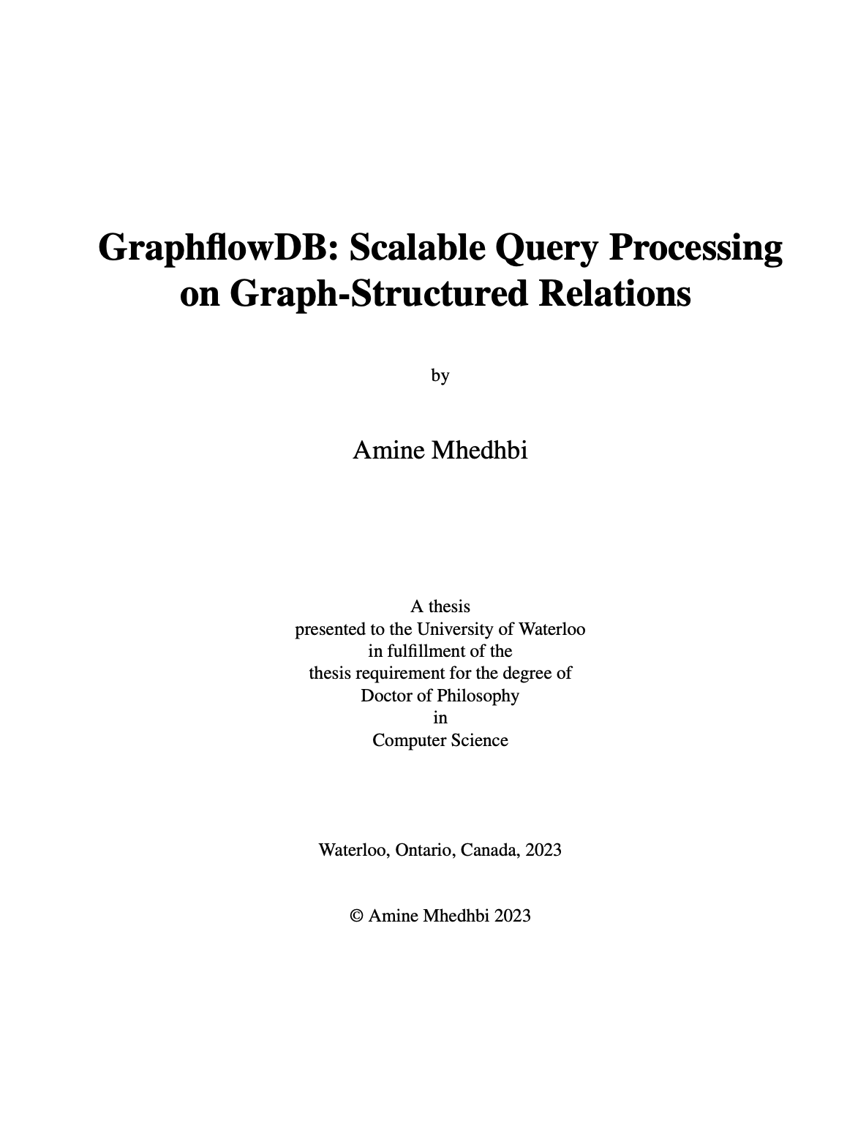
D-Representation-based Processor (2)
LDBC Social Network Benchmark, Scale factor 10, 176M edges
Ex:
GF-FRep vs GF-DRep
MATCH
WHERE a.name=‘Alice’ & e₄.date > 2021-03
Knows
Knows
memberOf
e₄:contains
a:Per
b:Per
c:Per
d:For
e:Post
 | IC1 | IC2 | IC3 | IC4 | IC5 | IC6 | IC7 | IC8 | IC9 | IC10
GF-FRep | 7.1 | 6.5 | 80.4 | 0.36 | 188.0 | 21.0 | 0.17 | 0.05 | 181.5 | 0.85
GF-DRep | 0.2 30.0x | 3.0 2.2x | 5.2 15.3x | 0.40 0.9x | 5.8 32.1x | 0.9 23.0x | 0.17 1.0x | 0.07 0.7x | 9.7 18.7x | 0.21 4.1x
runtimes in seconds

Slide 46
Final Remarks on Factorized Query Processing
A never ending quest in DBMS literature with graph data models, e.g., contemporary GDBMS, RDF systems, or XML DBs:
An alternative algebra with operators that take in/out (sub) graphs.
But most data management tasks require relational algebra.
Factorized DBs take a step in this quest: what is passed between operators (or for us what is cached) are effectively subgraphs.

Slide 47
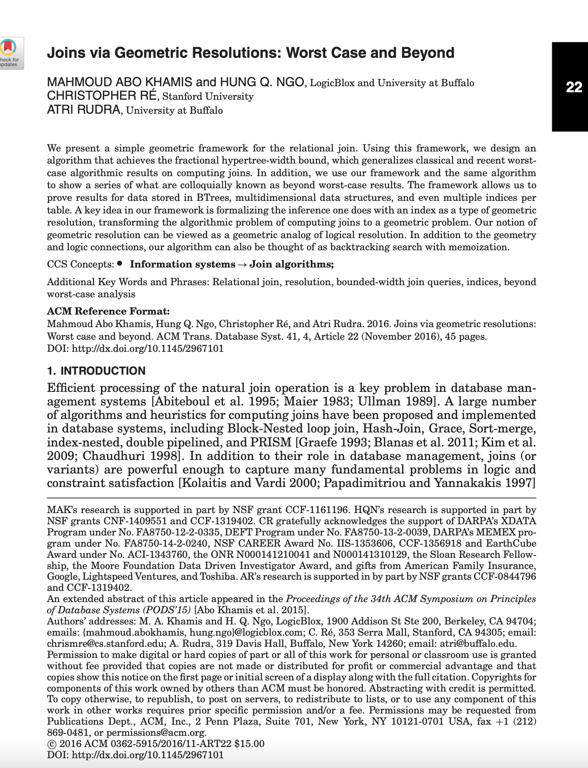
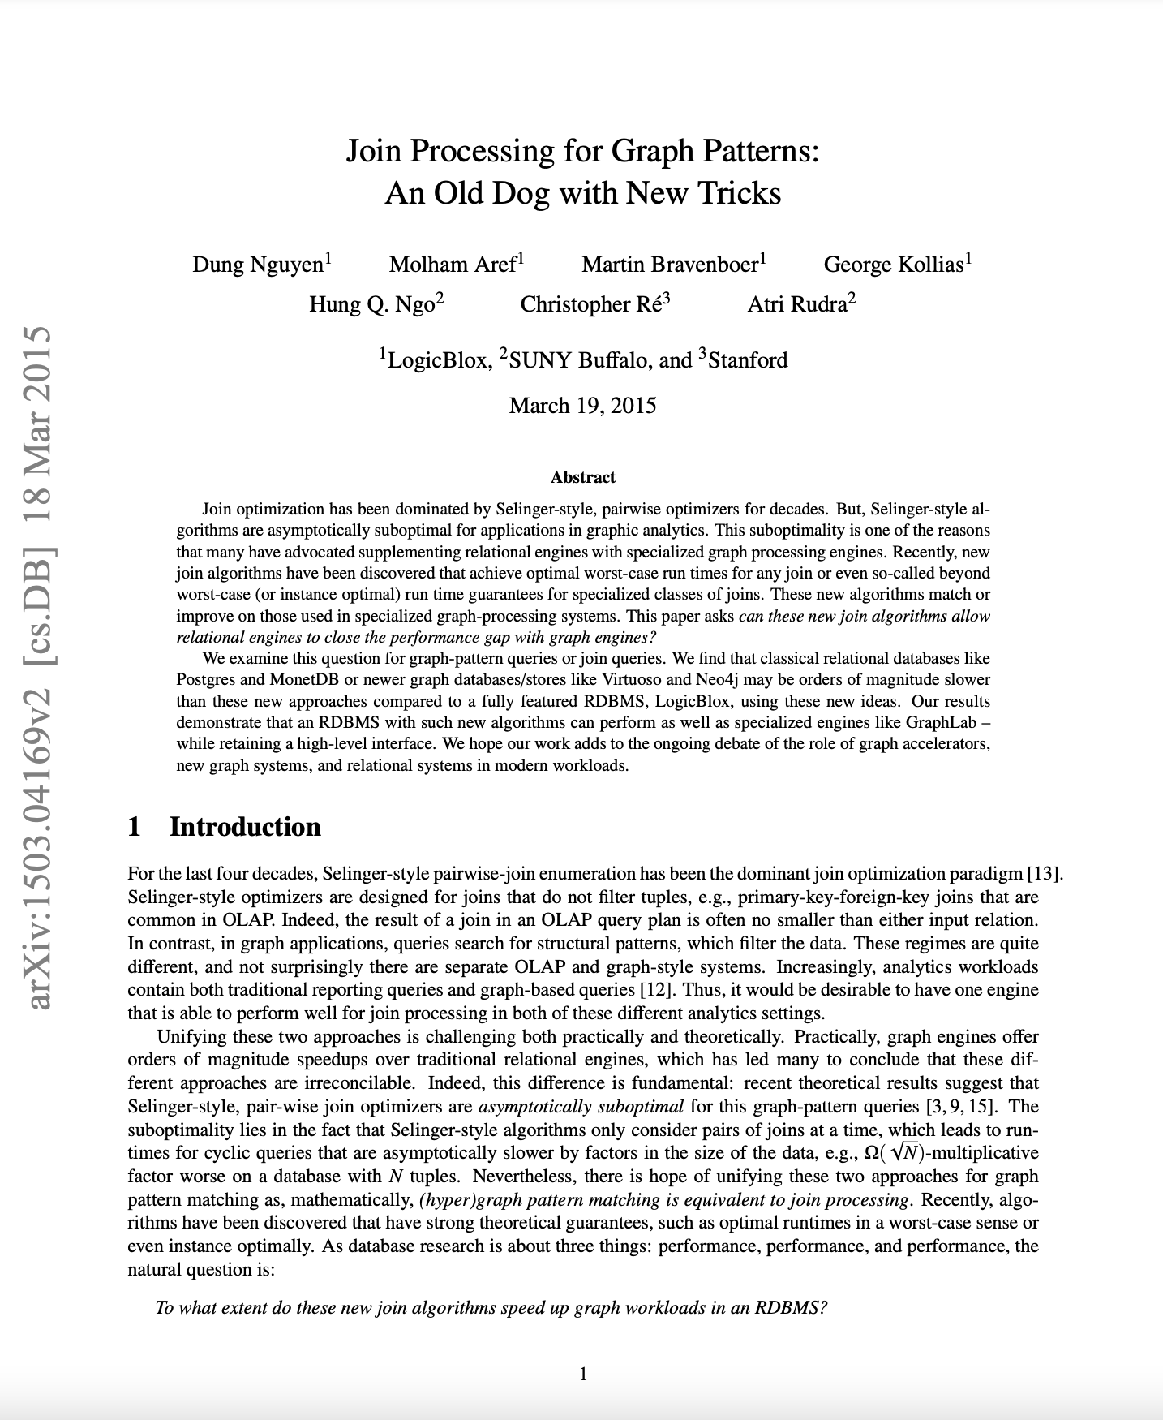
Only 1 implementation-based paper ever. (GRADES 2015 Workshop)

Slide 48

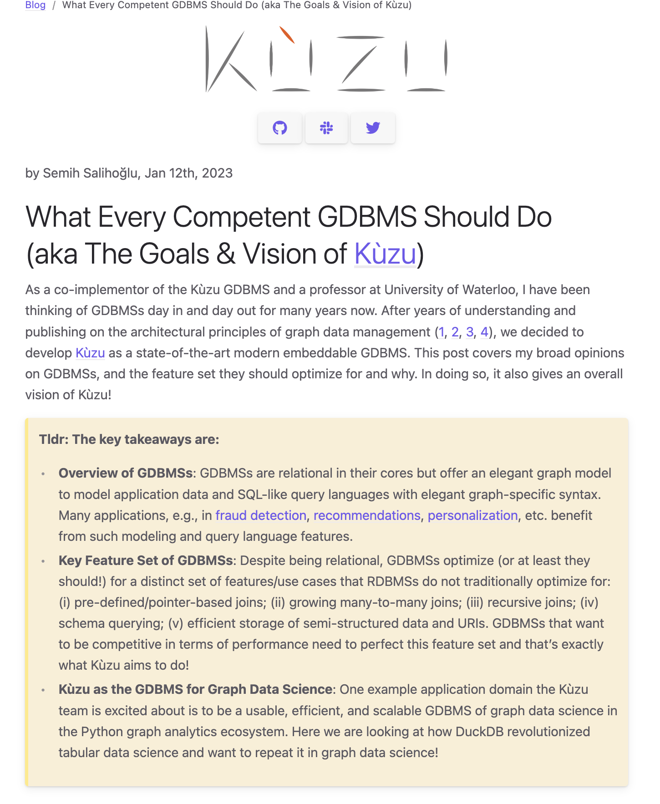

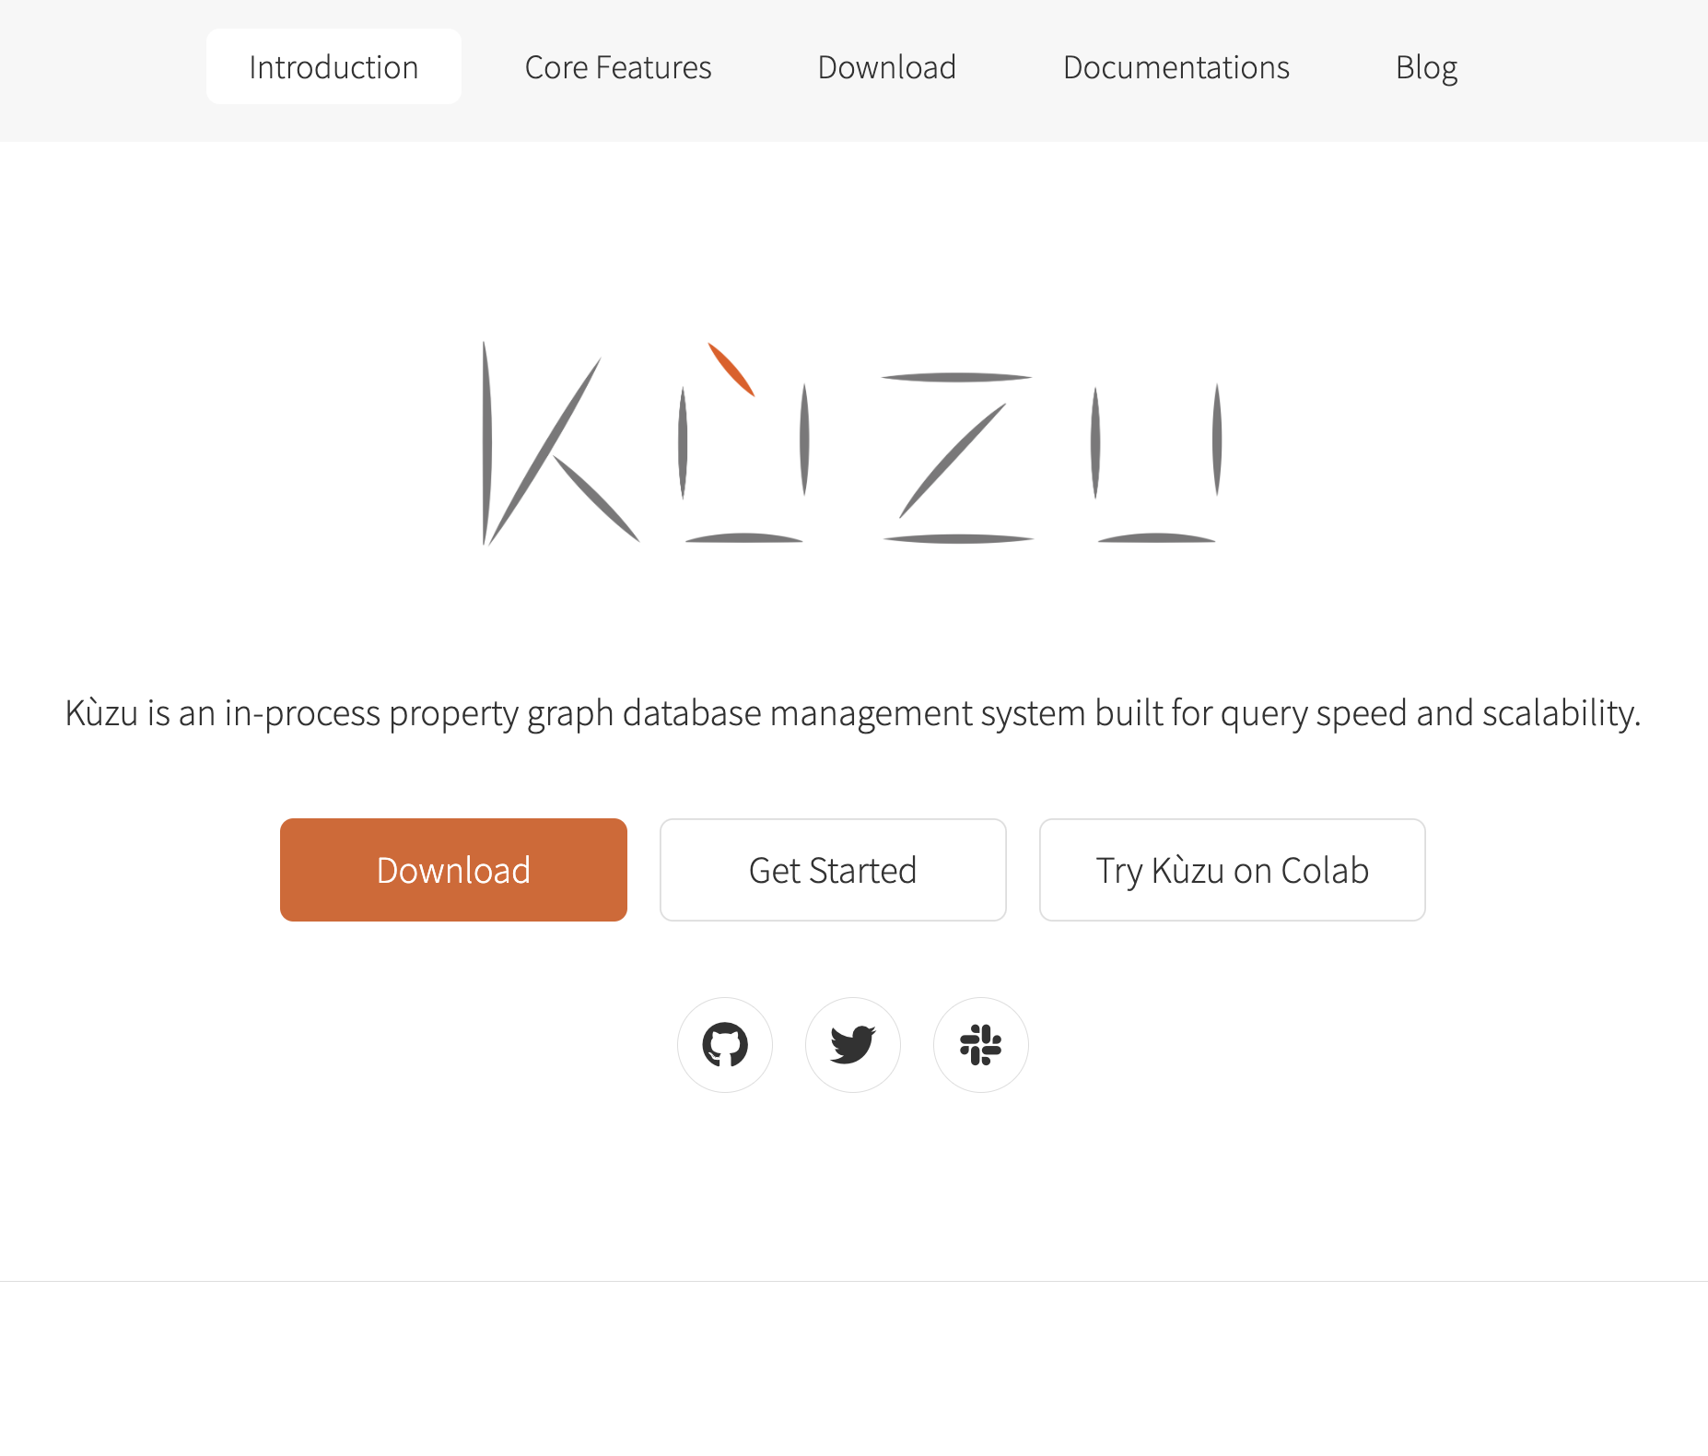

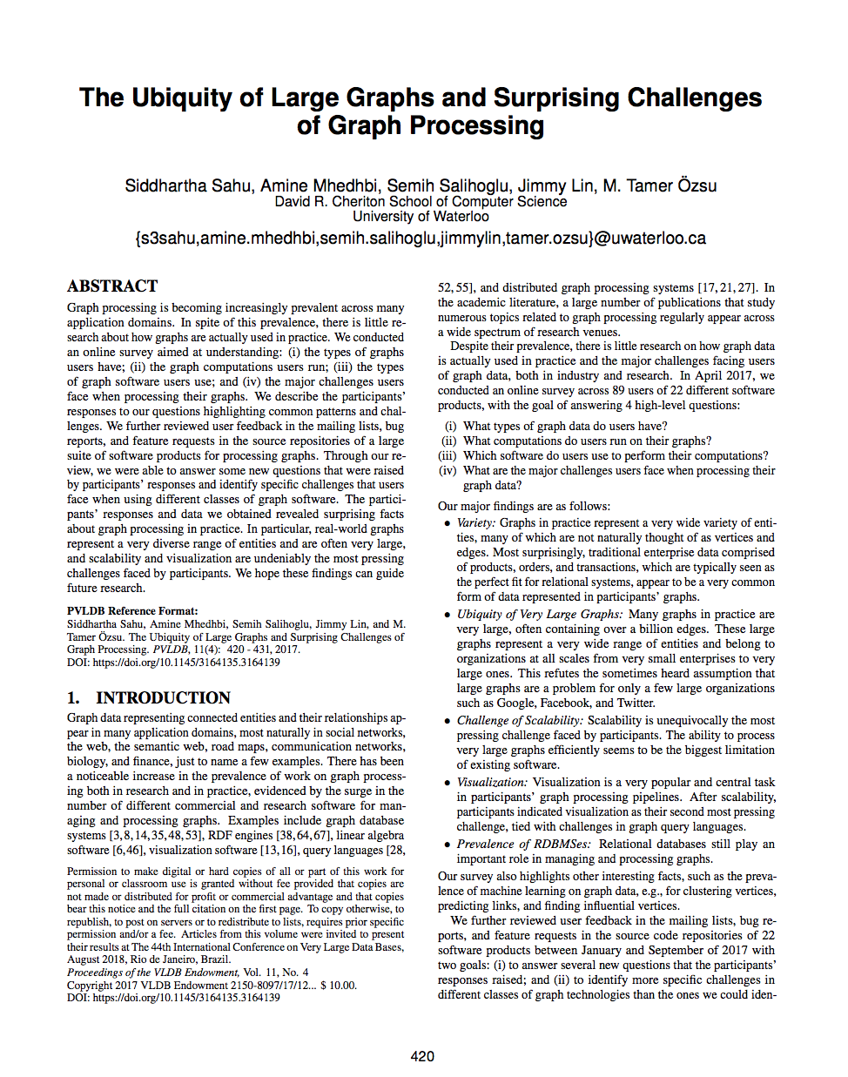
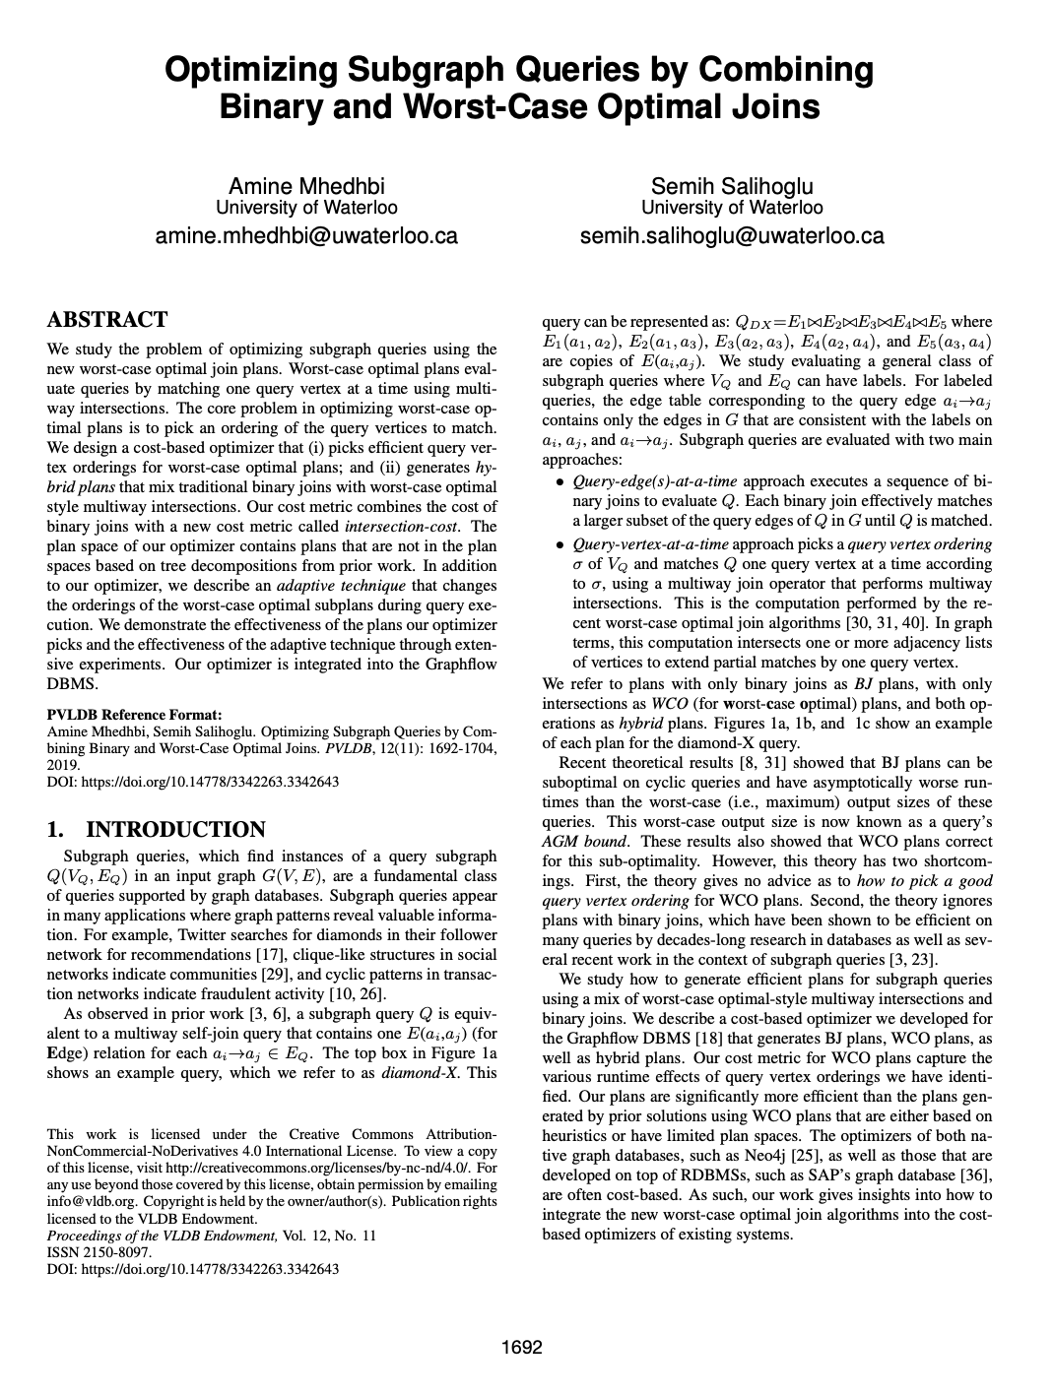
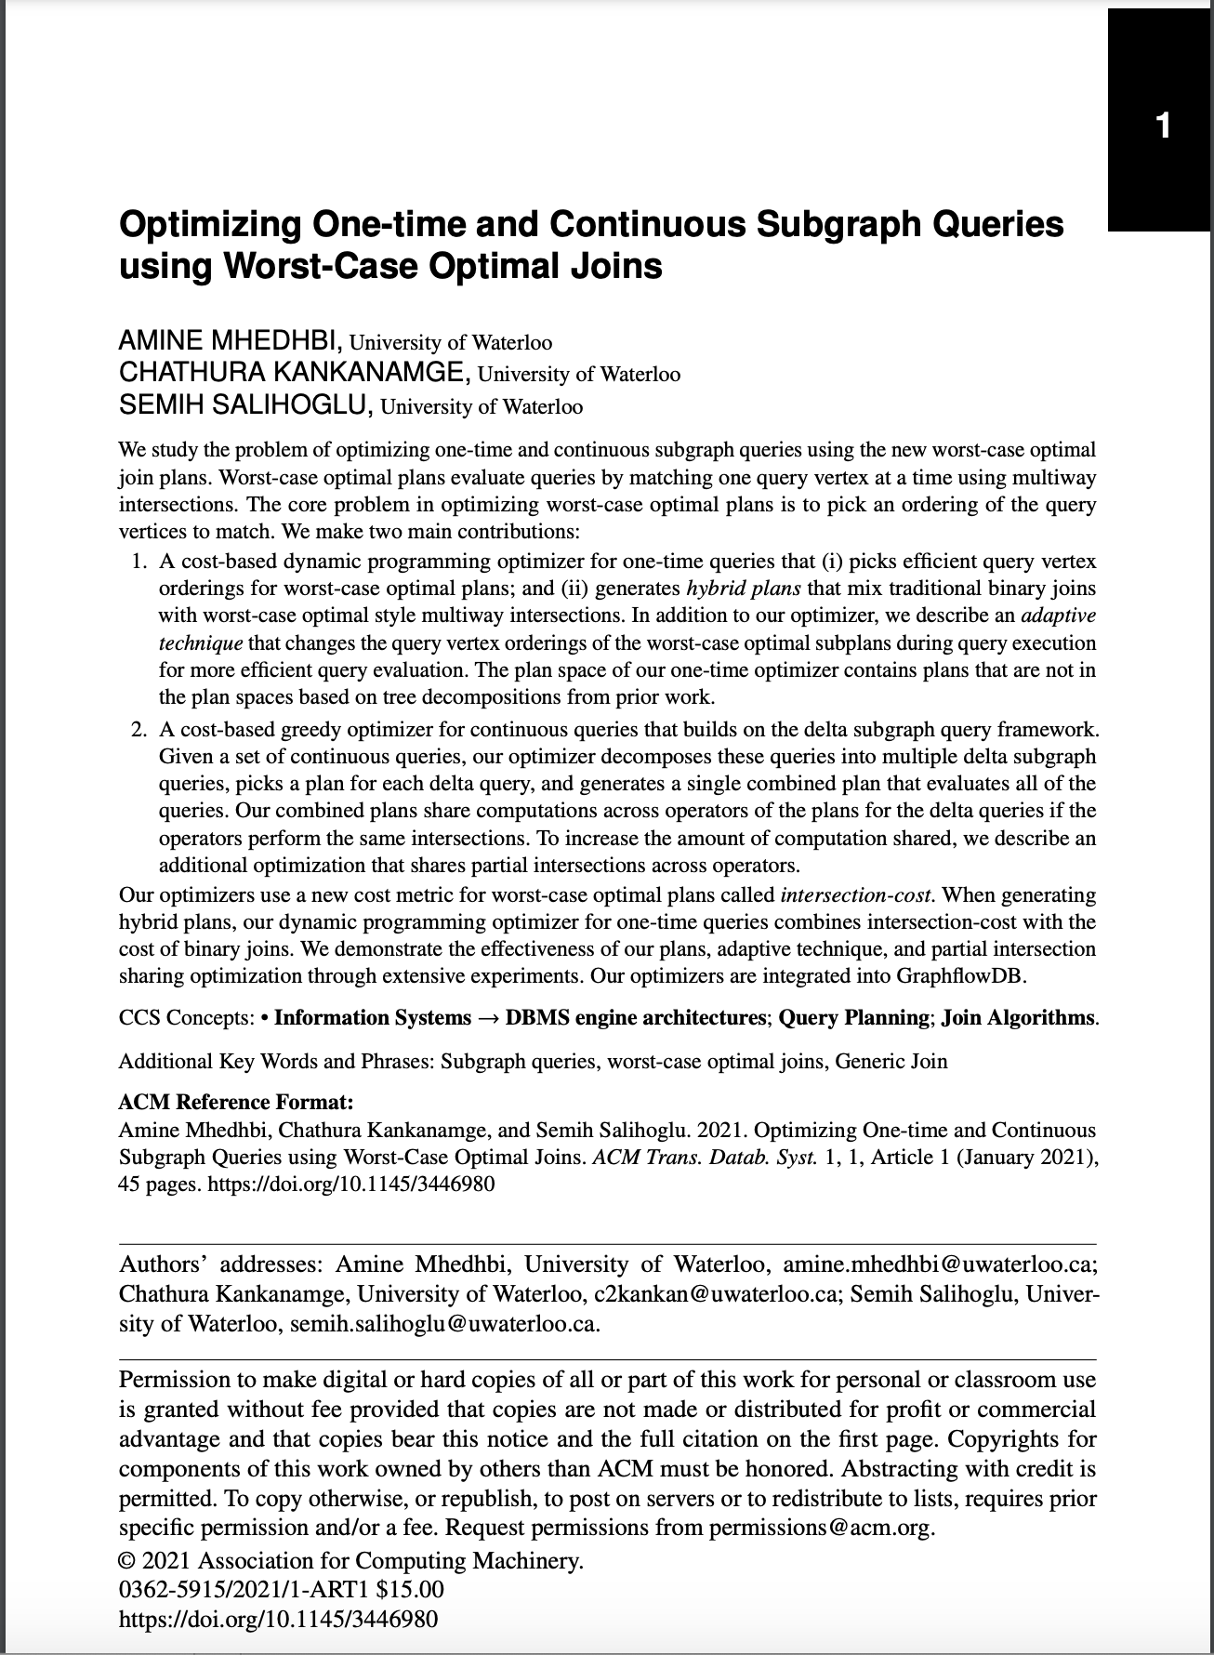
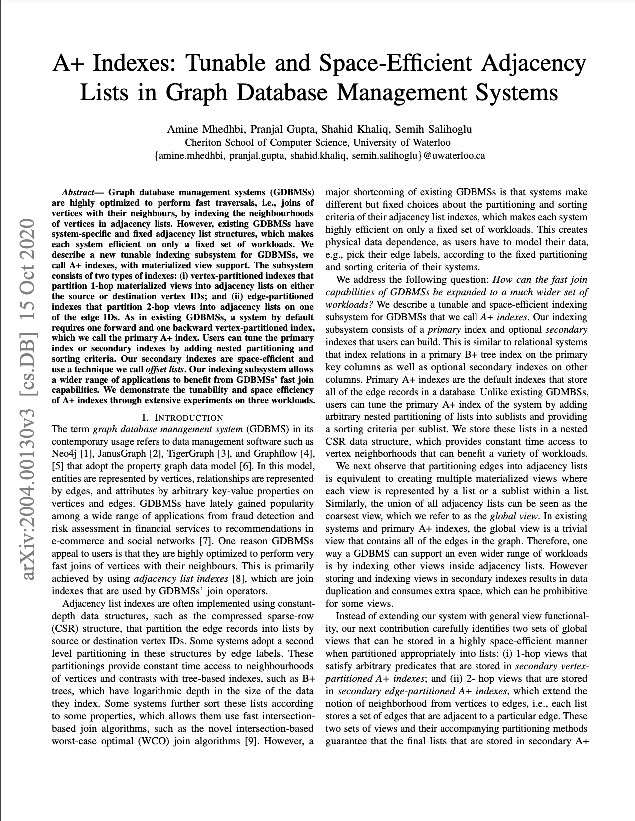
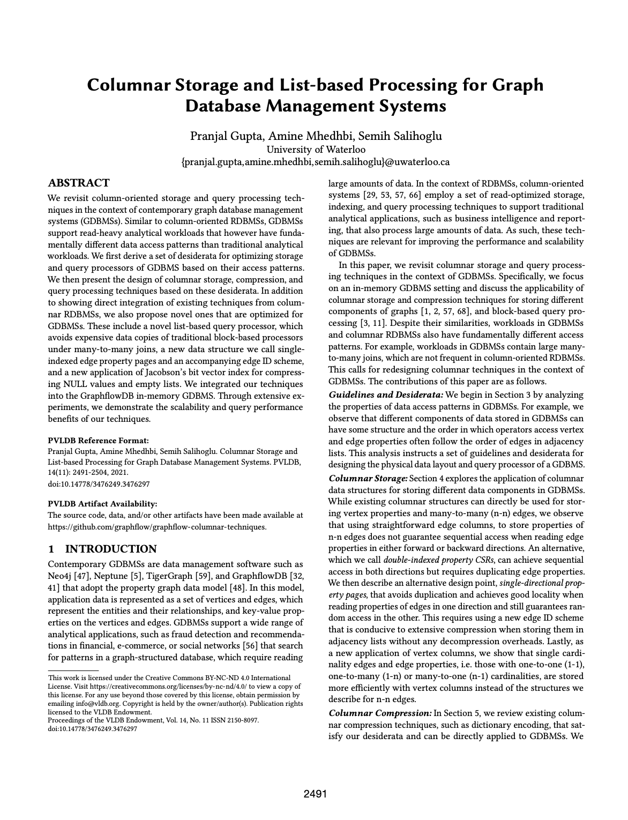
Try it out & Star us on Github!
pip install kuzu!
Blog
Github
Website
Youtube
VLDB
2018
VLDB
2019
TODS
2021
ICDE
2021
VLDB
2021
CIDR
2023

Slide 49
Other References
Size Bounds for Factorised Representations of Query Results, Olteanu, Zavodny, TODS 2015
Factorized Databases, Olteanu, Schleich, SIGMOD Record 2016
Worst-case Optimal Join Algorithms, Ngo, Porat, Ré, Rudra, PODS 2012
Skew Strikes Back: New Developments in the Theory of Join Algorithms, Ngo, Ré, Rudra, SIGMOD Record, 2014
Size Bounds and Query Plans for Relational Joins, Atseria, Grohe, Marx, FOCS 2008
The Ubiquity of Large Graphs and Surprising Challenges of Graph Processing: Extended Survey, Sahu, Mhedhbi, Salihoglu, Lin, Ozsu, VLDBJ, 2019

